Slide 1

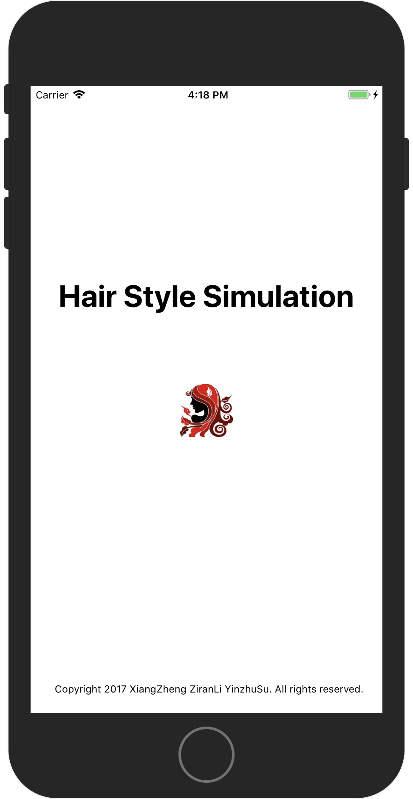
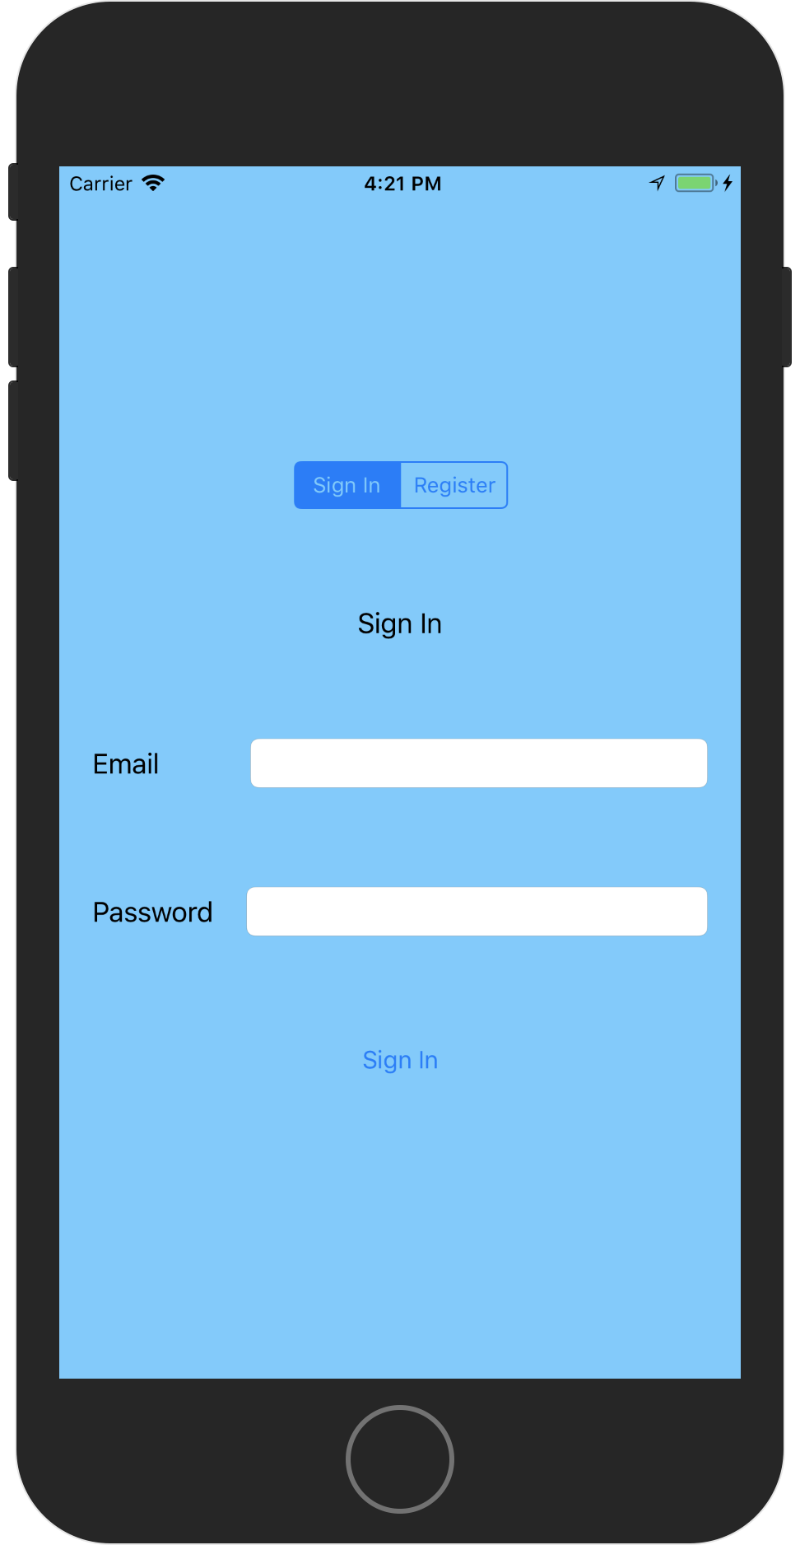
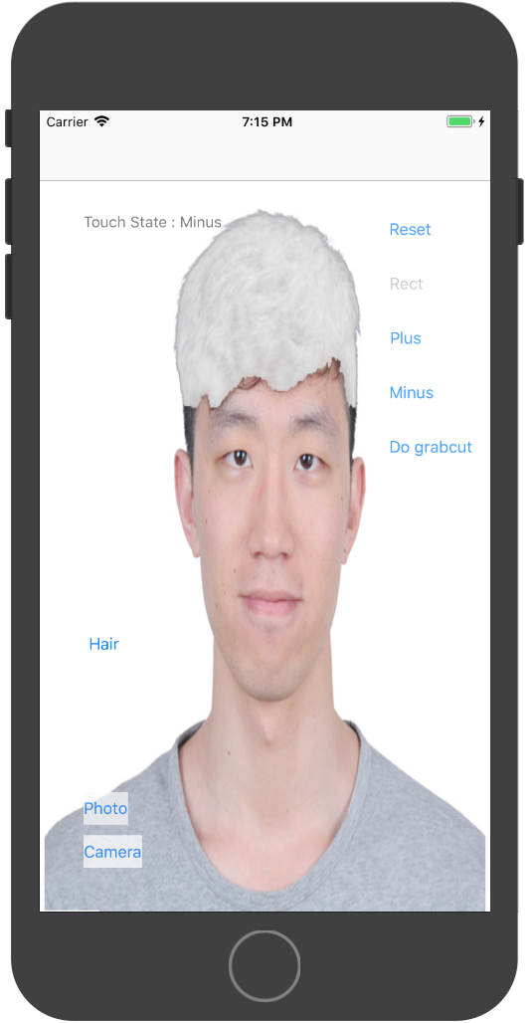
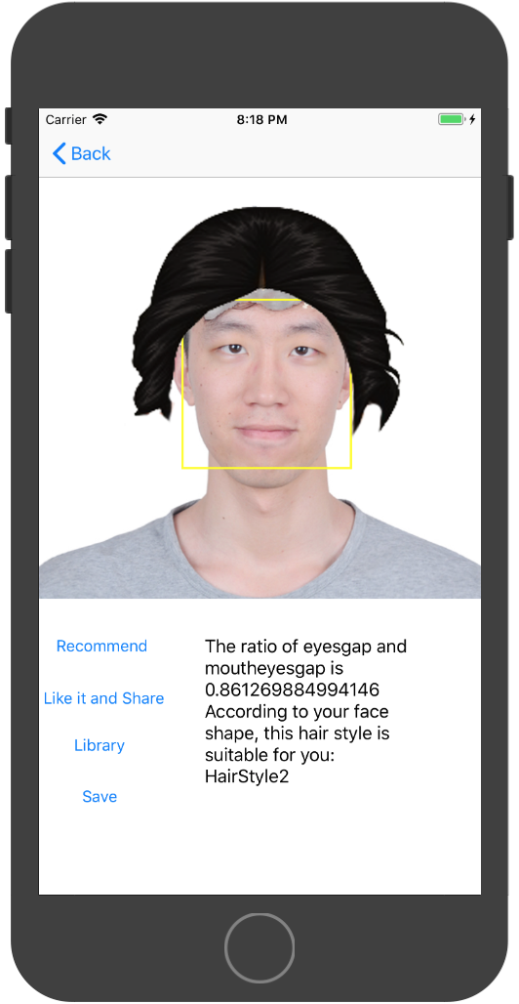
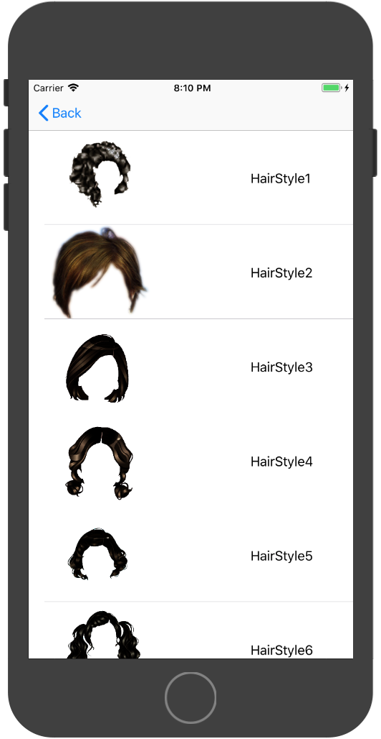
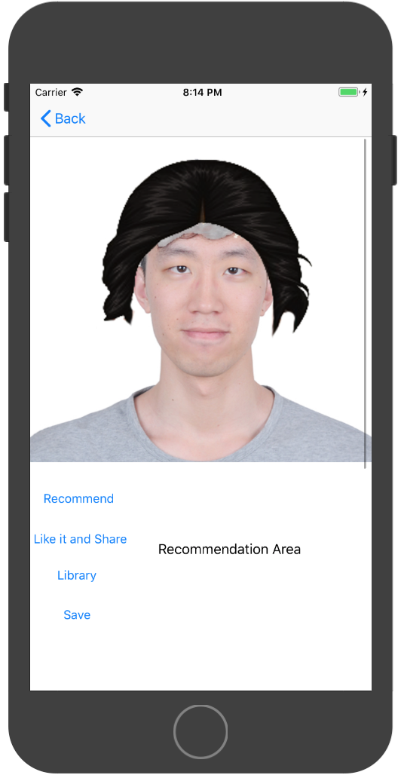

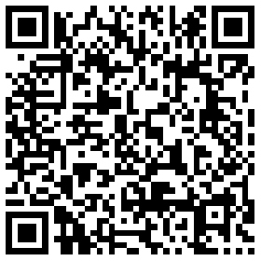
HAIR STYLE SIMULATION
Xiang Zheng, Ziran Li and Yinzhu Su
Department of Electrical& Computer Engineering, Boston University
郑翔的邮箱, zrli@bu.edu， 老苏的邮箱
Introduction
iOS application
Detect human hair part with user interaction
Remove the old, try new hairstyles on!
中间可以写techniques, accomplishments, 或者其他的
这里可以写个save share 等等 我还没想好
Firebase
Register with email
Already registered? Sign in!
Google Firebase
Grabcut
Our recommendation
Grabcut algorithm
Interactive Foreground Extraction
Core Image algorithm
Based on the data of face, give hairstyle recommendation
Select hairstyle
Match with your face
Hairstyle selection
Hairstyle matching
Github
Trello

